Slide 1
Pothole Detection
By Vismaya kalyan, Chethan Kothwal
Based on “Computer Vision Based Detection and Localization of Potholes in Asphalt Pavement Images “

Slide 2
PROBLEM STATEMENT
Pothole is one of the significant problems on roads and highways.
Currently pothole detection is mostly done either through a manual approach by experts or by high-end equipment using 3D reconstruction, stereo-vision, laser and vibration based approaches
The paper we have chosen implements a way to detect them using histogram of oriented gradient and predicting it using the naive bayes classifier. Localization of the pothole is done using canny edge detector and active contours

Slide 3


PROPOSED SOLUTION
HOG feature extraction:
HOG is used in CV basically for object detection
Fx and Fy are computed using the masks Mx = [-1 0 1] My = [[1], [0],[ -1]]
2) Magnitude of the gradient
3) Orientation of the gradient

Slide 4
Orientation calculated are normalized in the range of [0,180] to focus only on unsigned orientations.
Image size of 200x200 is divided into 625 (25x25) non-overlapping cells of 8 x 8 pixels. Each 8x8 cell is further divided into 4 blocks having 4x4 pixels in each block.
Then gradient orientations histogram is calculated for each block by quantizing gradient orientations into 8 bins. These 8 bins are evenly spaced over the interval [0°, 180°]
Each pixel has a weighted vote for its corresponding bin based upon the gradient magnitude and orientation. HOG feature extraction resulted in a feature vector VF of size 1x 20000 (625x4x8).

Slide 5
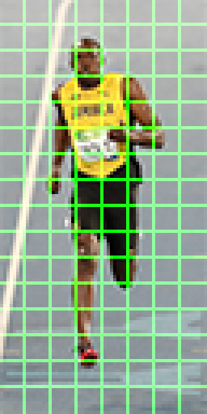
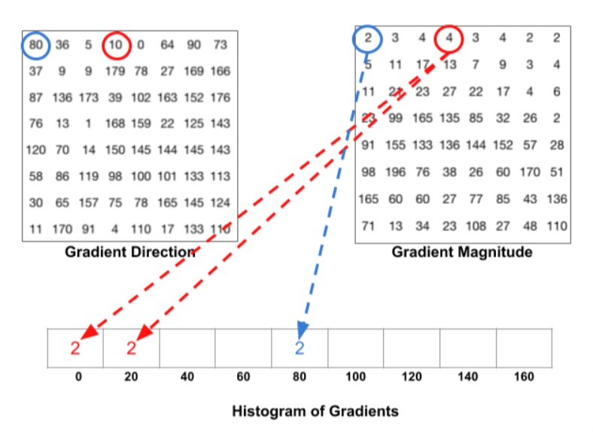

Slide 6
Training the classifier
All the HOG feature vectors obtained for all the images are then divided into train and test split.
Pushed to a naive bayes classifier (Gaussian NB) as mentioned in the paper.
Tried it on few others like KNN, SVM, Bernoulli Naive Bayes
Find the accuracy, precision and recall for estimating the performance.
Predict on a input image

Slide 7
Pothole Localization
A pothole in the asphalt pavement may contain the coarser (dry) or smooth (with water) texture as compared to local neighborhood.
Canny edge detector is used for Pothole localization.
Determine the intensity gradients
Magnitude and angle of the directional gradients
Non-maximum suppression
Double Thresholding
Edge tracking by hysteresis
Edges with high intensity from canny edge detection are marked with contours.
Pothole is highlighted in the image by drawing a rectangle.

Slide 8
RESULTS
Dataset containing 120 images of pothole and non-pothole images
Training - 80 images
Testing - 40 images
Classifier | Accuracy, Precision and Recall
Gaussian Naive Bayes | Accuracy = 0.975609756097561 Precision = 0.9655172413793104 Recall = 1.0
Bernoulli Naive Bayes | Accuracy = 0.7692307692307693 Precision = 1.0 Recall = 0.5714285714285714
KNN | Accuracy = 0.8292682926829268 Precision = 1.0 Recall = 0.75
SVM | Accuracy = 0.6829268292682927 Precision = 0.6829268292682927 Recall = 1.0

Slide 9
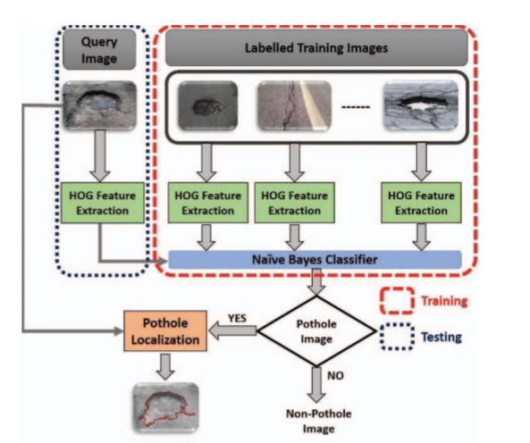
SUMMARY

